Slide 1
N177
AZTEC GOLD BOLT ON
CARLY ALBRIGHT
NATHAN WARMS
DESIGN BRIEF
12/2/2021

Slide 2
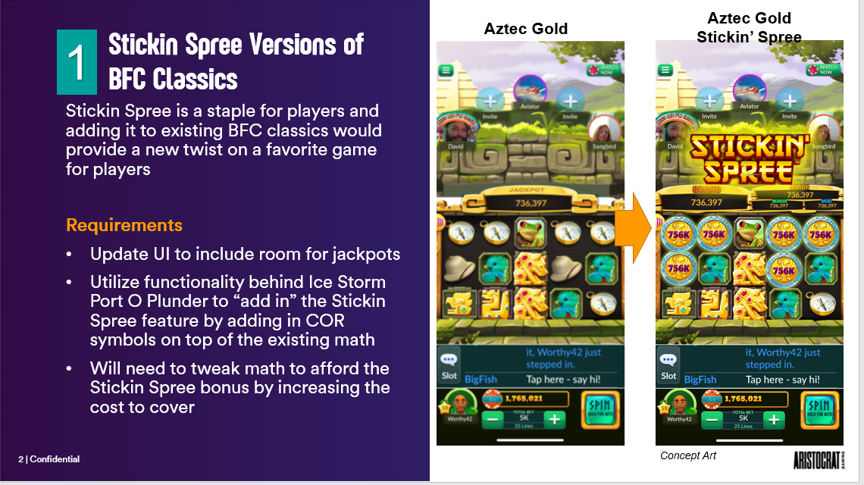

Slide 3
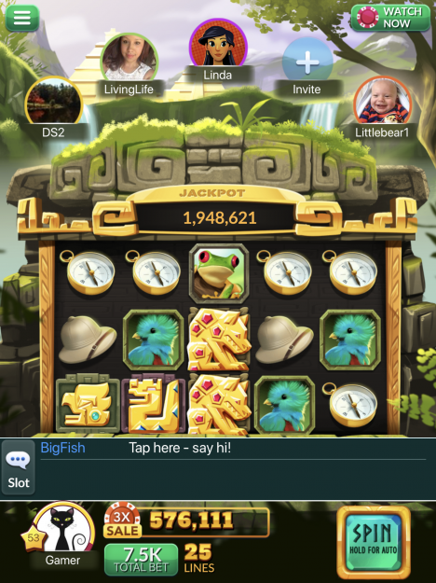

Base Game
Aztec Gold original base game
Jackpots are on COR symbols, except the grand which is awarded by a blackout in the H&S
Symbols include:
Compass
Hat
Binoculars
Quetzal
Frog
Jaguar
Bird
Snake
Hyena
Wild
Scatter
COR
Blank

Slide 4
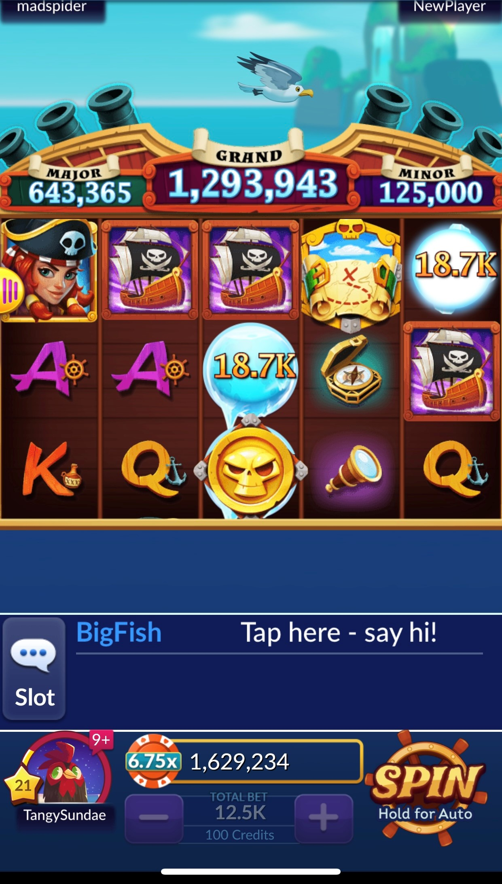
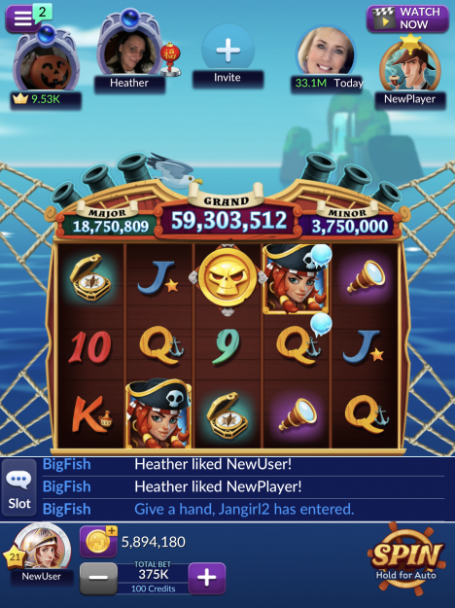
Base Game (cont.)
Sub symbols are added to the main symbols – these are “ghost reels”
See the ice balls on the image to the right – these land and reveal COR symbols
On a spin, a set of ghost reel spins while the normal reels spin and either land a COR or blank on each position while the BG symbols land too. After the CORs land they reveal the BG symbol underneath, and then disappear if less than 6 symbols appear. If 6 or more COR appear, the H&S feature is triggered. CORs do not block BG line pays.

Slide 5

Wheel
Triggered by 3 or more scatter symbols
FG are only triggered by the wheel – different wheels are triggered depending on how many scatters – 3,4, or 5
Other slices of the wheel include gold credits and credit multipliers
5 FG are triggered with 3, 10 FG with 4, 25 FG with 5
FG are same as the BG, and cannot be re-triggered

Slide 6
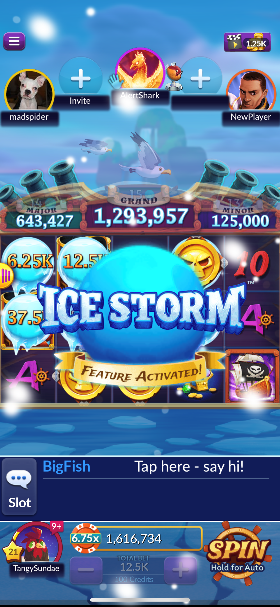
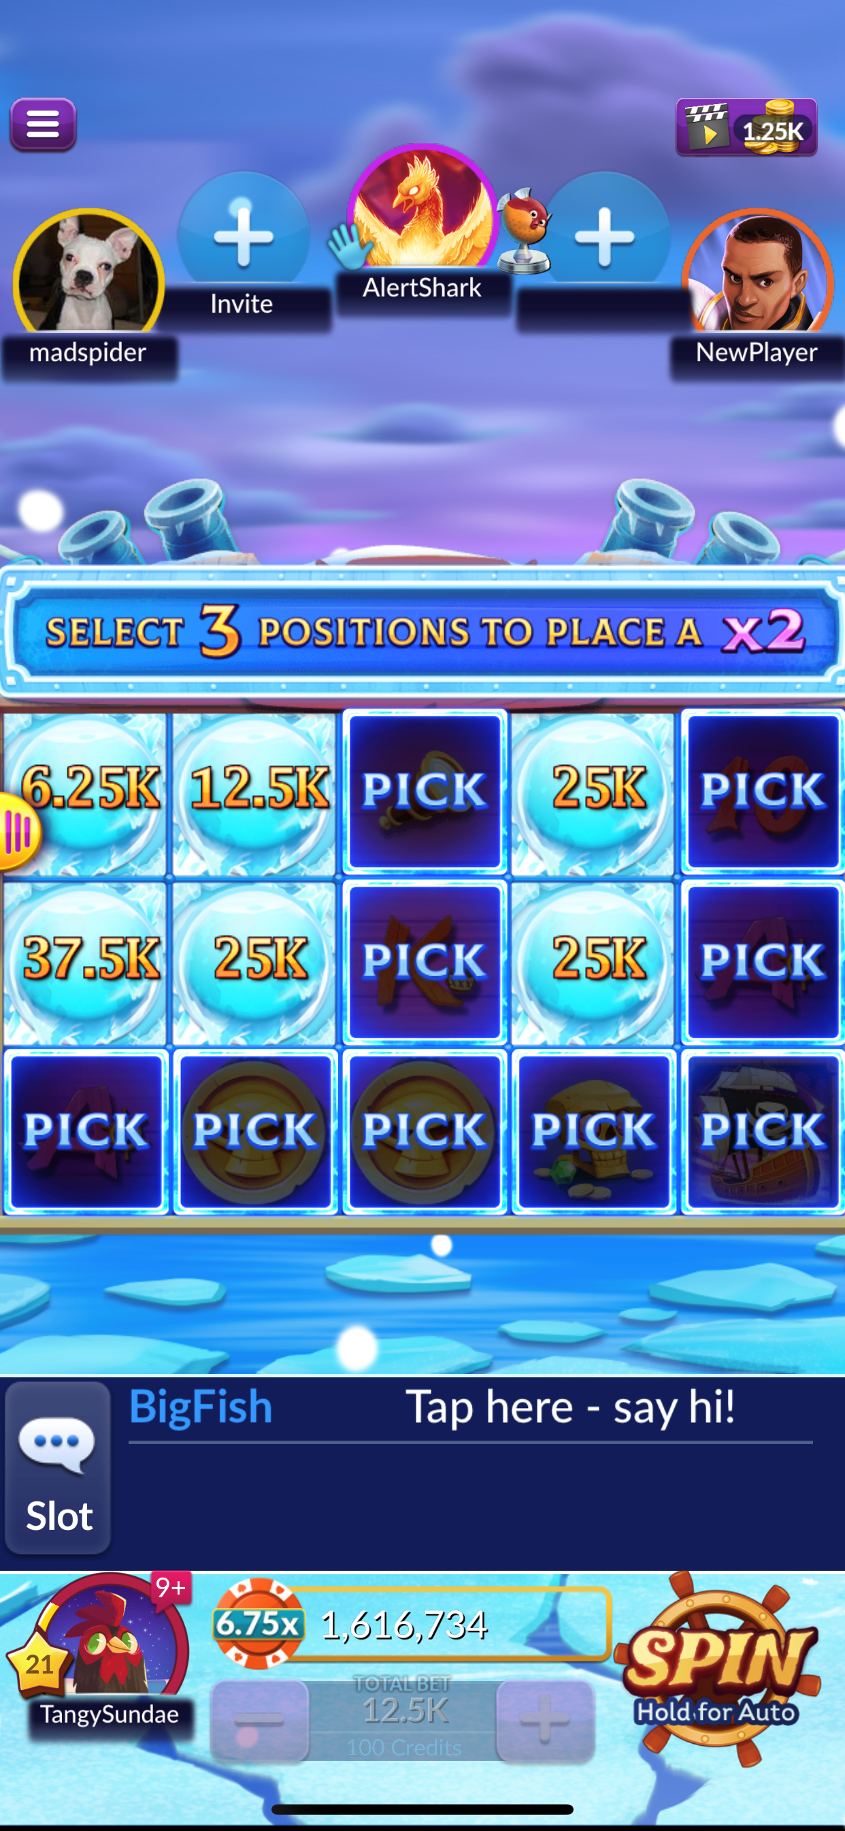
H&S Feature
If 6 or more COR land in BG, the H&S is triggered
Player selects three positions, first for a 2x, then a 3x, and finally a 5x multiplier. A final multiplier feature is as follows: if the player fills in all three positions all values on the reels are multiplied by a randomly chosen multiplier from a pool of 2x, 3x, or 5x. (The original games uses 2x multipliers as shown to the right)
Typical H&S features – begin with three spins, three spins are reset if another H&S symbol lands
Different reel sets depending on the number of CORs the H&S is triggered with

Slide 7
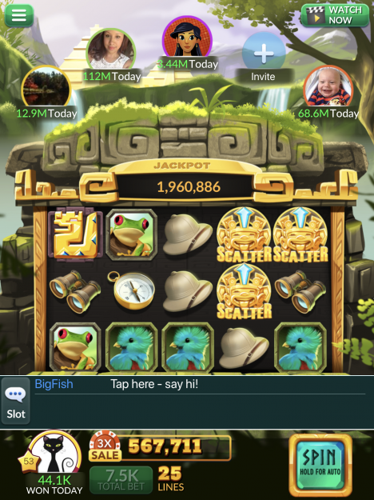
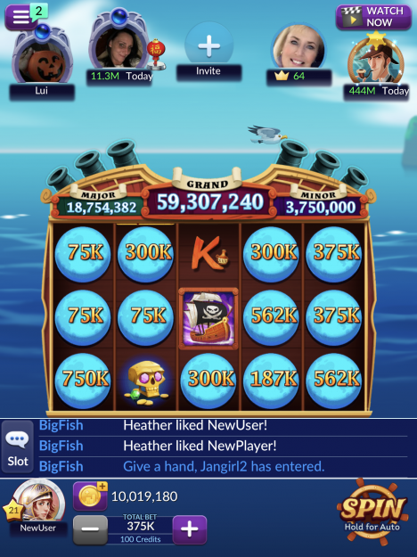
Reference Games
Uses Aztec Gold base game
Uses ice storm/port of plunder for the H&S feature

Slide 8
Carly Albright
3x5, 25 lines, ice storm
Portrait
Wheel, Free Games, H&S
4 jackpots, mini, minor, major, geand
Gambler

Slide 9
Carly Albright
carlyn.Albright@pixelunited.com

